Slide 1
New Member Orientation
November 19, 2025 (Rev 2)
Notes:
Trainer Tip: Enter additional information as you see fit, such as the name of the New Member Orientation trainer. Use this PowerPoint along with the New Member Orientation Training Guide. Be sure each of your participants has a New Member Orientation Guide to follow along with the presentation.

Slide 2

New Member Orientation Summary
New member orientation is broken out into
four sections:
  Who Lions Are
  Your Club
  District and Multiple District / Lions of the United States
  Lions Clubs International (LCI)

Slide 3

Who Lions Are
Lions are men and women dedicated to serving those in need, whether in their own community or around the world.
  Over 1.4 million members
  Over 200 countries
  More than 48,000 clubs

Slide 4

Who Lions Are
Vision Statement: To be the global leader in community and humanitarian service.
Mission Statement: To empower volunteers to serve their communities, meet humanitarian needs, encourage peace and promote international understanding through Lions clubs.
Motto: “We Serve”
Slogan: Liberty, Intelligence, Our Nation’s Safety
Purposes: LCI has a list of purposes to convey why Lions clubs exist.
Code of Ethics: LCI has a code of ethics which set the standard that Lions should aspire to adhere to.

Slide 5
Your Club
Insert your Club Logo of Banner Here

Slide 6

Background
Year chartered:
Number of charter members:
Sponsored By:
*Members joining within 90 days of the charter date are charter members.
Notes:
Trainer Tip: Edit this slide as you see fit. Remove things that don’t apply to your club, or add things that are not currently included.

Slide 7
Club Officers
President:
Immediate Past President:
Vice President:
Secretary:
Treasurer:
Membership Chairperson:
Directors:
LCIF Chairperson: < Typically, Immediate Past President>
Marketing/Communication Chairperson:
Service Chairperson:
Lion Tamer*:
Tail Twister*:
*Optional
Notes:
Trainer Tip: Add the names of the current club officers. Add or remove bullet points if your club has different officers than those listed.

Slide 8
Elections
Officers are elected annually
Club president appoints a nomination committee in March
The nomination committee selects candidates
The club votes on slate of officers in April
Club Secretary reports new officers to LCI NLT May 15th
The term begins July 1st

Slide 9
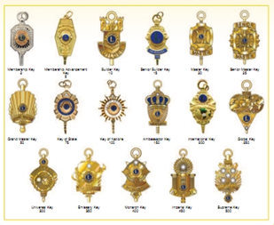
Awards
While service is its own reward, special accomplishments and milestones should be recognized and celebrated. The awards below are awards that all Lions can achieve.
Membership Keys
Chevrons – years of service
Member Sponsor Recognition
Extension Awards
Notes:
Trainer Tip: Add additional information to this slide to show additional awards that are available through your club, district or multiple district.

Slide 10
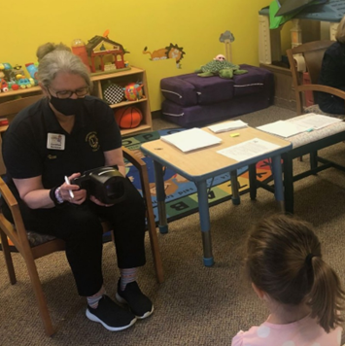
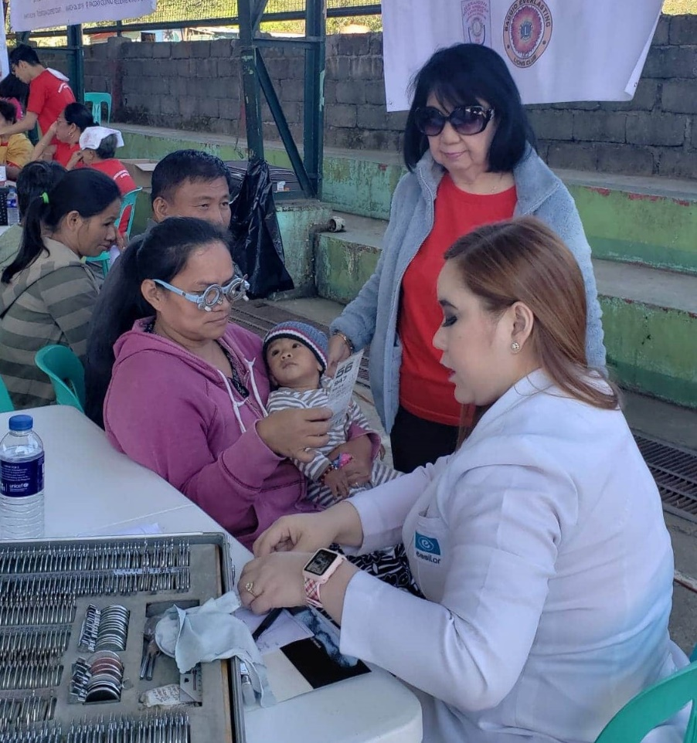
Service Project Ideas - Vision Screening

Slide 11
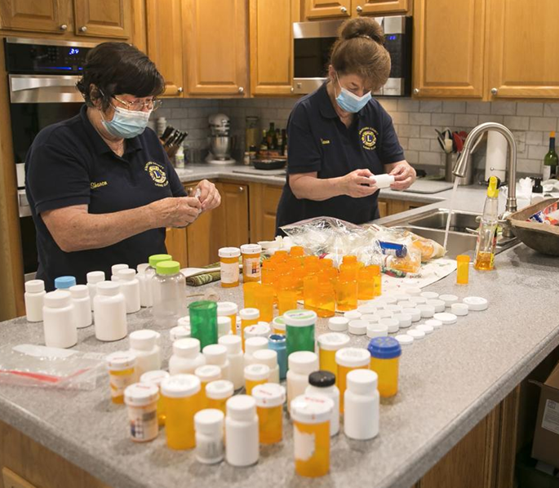

Service Project Ideas - Pill Bottle Recycling
Notes:
Speaker Notes: The Stafford County Lions Club recycles pill bottles for use on medical missions. This is an example of a community need that was discovered through the local newspaper by Lion Sharon Gaylord. She and Karen Taylor Wash process the pill bottles by removing labels, washing and packaging for shipment to Matthews 25. During the pandemic medical missions were suspended so the pill bottles were given to animal shelters for use by the veterinarians

Slide 12
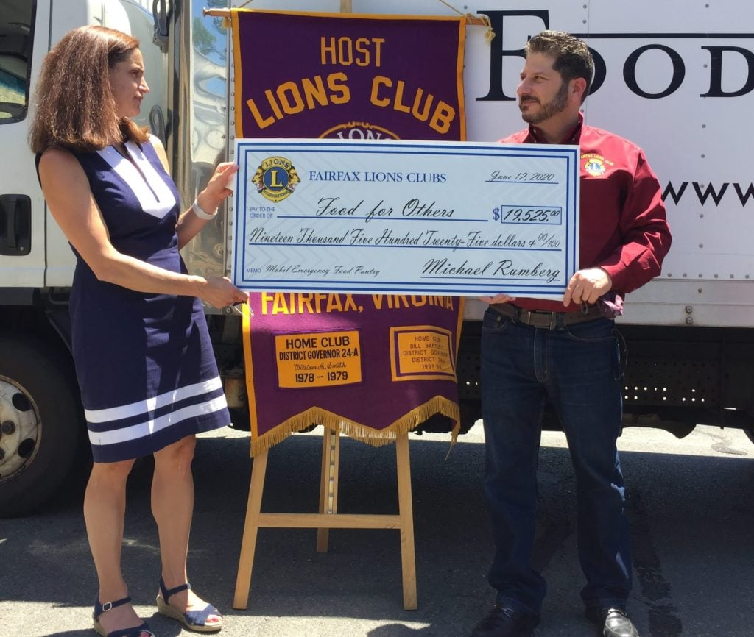
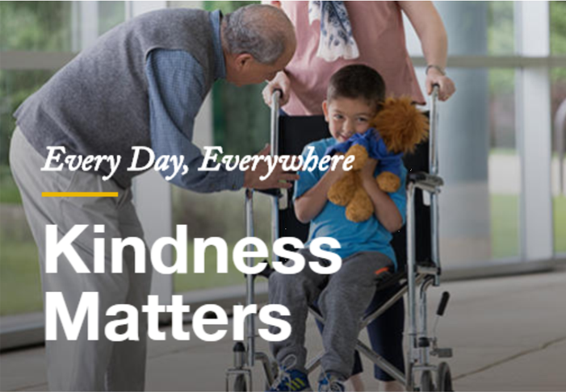
Kindness Matters Service Award
In Honor of the late Judge Haynes Townsend, 1IVP
In 2021, Fairfax Host Lions Club collaborated with several
Other clubs to raise over $20,000 for a mobile food pantry truck.
Notes:
Speaker notes: Don’t be afraid to harness the power of our association to create large-scale projects. For example, the Fairfax Host Lions worked with neighboring clubs to raise $20K to purchase a vehicle for the foodbank to deliver food to clients during Covid-19. What a great idea that will keep the Lions in mind for years to come. This project was recognized by LCI with a Kindness Matters Service Award in 2021.

Slide 13
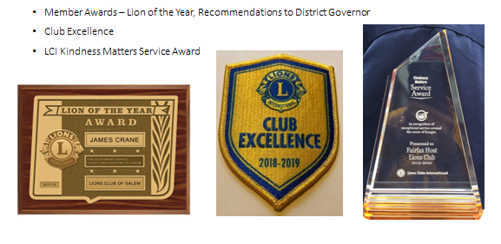
Celebrating Service
https://lionsuniversity.org/wp-content/uploads/Art-of-Recognition.pdf
2025-2026 District 24-L Club Officers Workshops

Slide 14
Fundraising
<Insert a list of your fundraising activities here>
Additional Fundraising ideas
How about sponsoring organizing a Lions Bowling Tournament?
Garage sales/flea market
Dinner dances
50/50 at club meetings and events

Slide 15
Membership Benefits
The benefits of Lions Clubs membership are numerous,
and include:
Be part of a global community for good
Support, tools and resources to enhance your service
Leadership development opportunities
The satisfaction and joy of helping those in need
Networking opportunities with local and international community leaders
Friendship and fellowship with service minded people
Respect and credibility of being a Lion

Slide 16
Meetings
When:
Where:
Your Club, Your Way: You can decide what meeting format
best meets your club’s needs – in person, virtual or hybrid.
Notes:
Trainer Tip: Add any additional meeting information you feel is important.

Slide 17
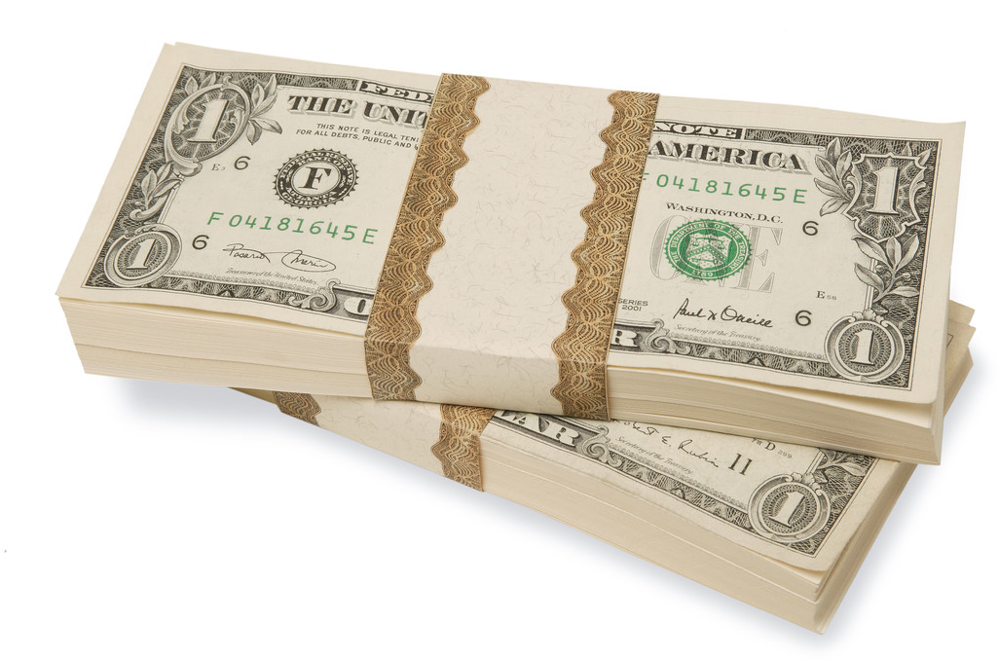
Dues and Budgets
Annual Dues
  Club dues: $___, which include:
    Multiple District dues: $16
    International dues: $50*
    Remaining amount collected stays in the club admin account
Activities Budget – Commonly known as the Charity Account; funds collected from the public
Administrative Budget – covers the cost of operating the club and paying MD and LCI dues; funds collected from members
*Family Members - International dues are invoiced at $25/year
Notes:
Trainer Tip: Explain that the activities budget consists of funds raised form the public through club projects and may only be expended to satisfy a community or public need. The administrative budget is what finances club operations and comes mostly from club dues.

Slide 18
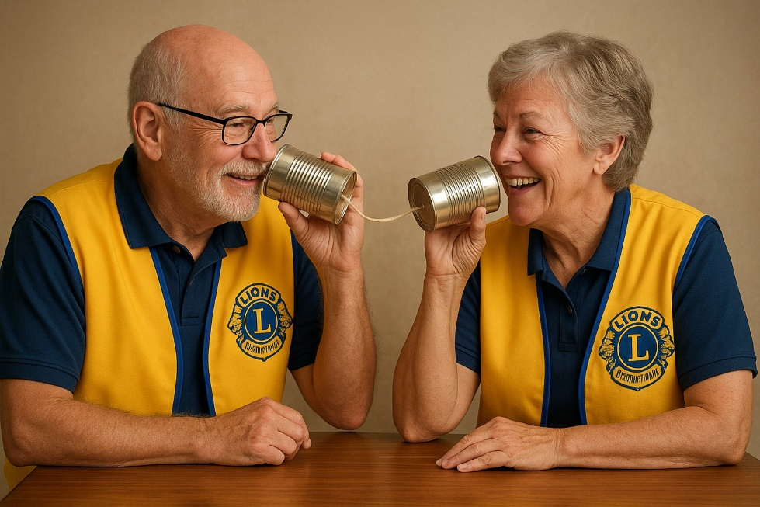
How We Communicate
Insert specific modes of club communication,
including telephone lists and chat groups.
Social Media
  Facebook
  Instagram
  YouTube
  X
Email Lists
Website – Custom website or free e-Clubhouse available, insert URL here.

Slide 19
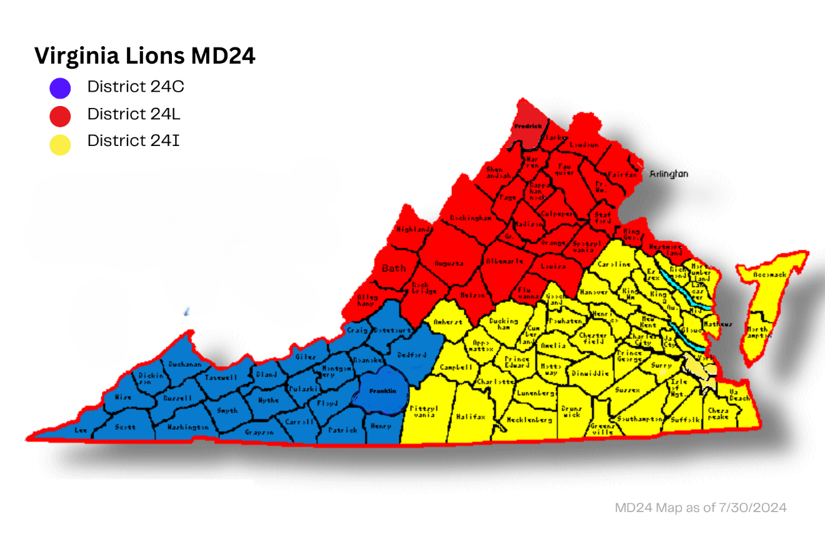
Our District & Multiple District

Slide 20
Organizational Structure
Worldwide there about 750 districts with 35 or more clubs and at least 1,250 members in each district.
  Each district has a district governor
Multiple districts are formed by two or more districts within a territory.
Our Multiple District: MD 24 Lions of Virginia
Our District: 24-L (Northern Virginia, West and South to the Blue Ridge and Shenandoah Valley)
Notes:
Trainer Tip: Consider adding additional information about your district and multiple district, such as boundaries of your district and multiple district.

Slide 21
District Leadership (July 1, 2025 – June 30, 2026)
District Governor- Dan Visone, Aquia Harbour Host
First Vice District Governor: Chuck Schwab, Broadway
Second Vice District Governor: Greg DeRosa, Fairfax Host
Cabinet Secretary: Vicki Davies, Stephens City
Treasurer: Thomas Rachele, Montclair Lions Club
Region/Zone: <Insert your Region/Zone here (Chair)>
Immediate Past District Governor: James Cech, Montclair
Council Chair: DG-E Dan Visone, Aquia Harbour Host
Global Action Team:
  Global Action Team District Chairperson (District Governor): Dan Visone
  Global Membership Team District Coordinators: PCC Glen Logan
  Global Leadership Team District Coordinator: PCC Wilma Murphy
  Global Service Team District Coordinator: Evelyn Marr
Notes:
Trainer Tip: Briefly go over the roles of each of these positions. The roles are found in the trainer and participant’s guide.

Slide 22
District Conferences and State Convention
District conferences are held to:
  Develop fellowship among the Lions of the district
  Conduct general district business
  Conduct seminars
District 24-L Fall Conference (2025)
  September 27, 2025: St. Paul’s Lutheran Church, Stafford, VA
District 24-L Winter Conference (2026)
  January 10, 2026: Winchester Moose Lodge, Winchester, VA
Lions of Virginia State Convention
  Develop fellowship among the Lions of the multiple district (across Virginia)
  Conduct general district business
  Elect the district governor and vice district governors
  Conduct seminars

Slide 23
How the District and Multiple District Communicate
Social Media
  Facebook – https://www.facebook.com/people/Virginia-Lions-District-24-L/61577663016545/
  Instagram – https://www.instagram.com/virgina_lions_24l/
  LinkedIn - https://www.linkedin.com/groups/4525259/
Websites
  District – valions.org
  Multiple District – lionsofvirginia.org
PawPrints Newsletter – transitioned to Webnews/BLOG on the new website

Slide 24
Lions Clubs International

Slide 25
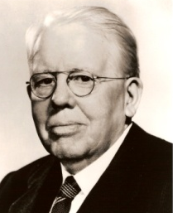
History
1917: Melvin Jones founded LCI.
1920: LCI becomes international with Canadian club.
1925: Helen Keller challenged Lions to become “knights of the blind.”
1945: LCI helped draft the United Nations Charter.
1957: The Leo Club Program is created.
1968: The Lions Clubs International Foundation is established.
1990: SightFirst is launched.
Today: Our international network has grown to include more than 200 countries and geographic areas.
1987: LCI became the first service club organization to admit women as members.

Slide 26

Name and Logo
The official name of the association is “The International Association of Lions Clubs” or simply “Lions Clubs International.”
The name Lions was chosen on a secret ballot over several others because the lion stood for strength, courage, fidelity and vital action.
The Lions logo consists of a gold “L” on a blue field surrounded by a gold circle. On either side of the circle is the profile of a Lion’s head, one looking back upon a proud past and the other looking optimistically toward the future.

Slide 27
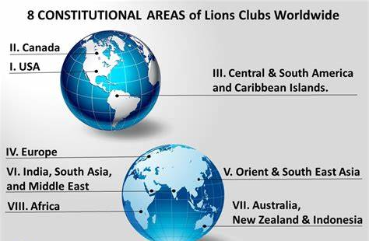
Lions Clubs International Organizational Structure

Slide 28

Constitutional Area I – LionsUSA.org

Slide 29
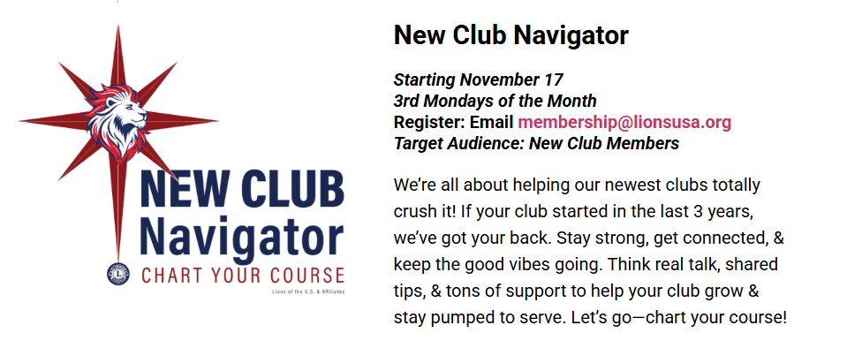
One of Several LionsUSA Resources

Slide 30
LCI Organizational Structure (Continued)
International officers implement policy and serve as inspirational leaders of the world’s Lions. Lion Year 2025-2026 Int’l Officers:
  International President: A.P. Singh, India
  First Vice President: Mark Lyon, Connecticut
  Second Vice President: Manoj Shah, Kenya
  Third Vice President: Tony Benbow, Australia
  Immediate Past President/LCIF Chairperson: Fabricio Oliviera, Brazil
The International Board of Directors is the governing body of the association.
  34 members
The International Constitution and By-Laws govern the operations of the association and establish the rules by which the association is to function.

Slide 31

International Convention
Convention brings together thousands of Lions from around the world for a week of business, education, celebration and fellowship.
To learn more visit LCICon.lionsclubs.org

Slide 32
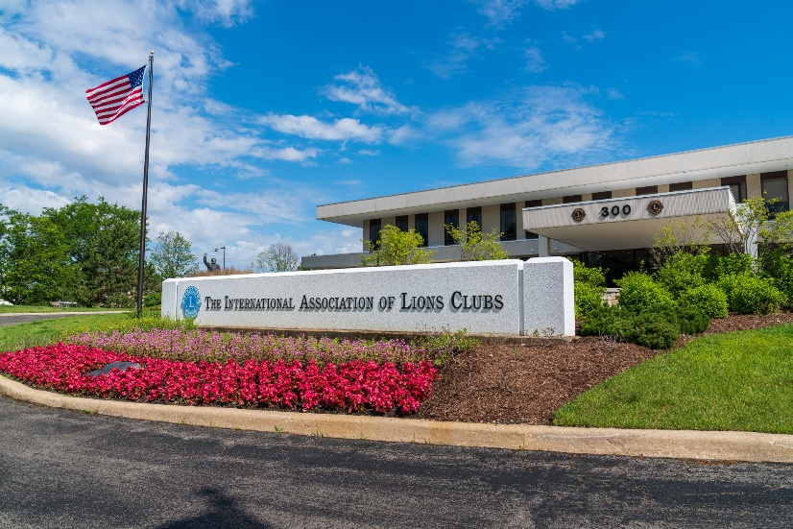
International Headquarters
Located in Oak Brook, Illinois
Approximately 275 staff members
in 11 divisions:
  Convention
  District and Club Administration
  Finance
  Information Technology
  Leadership Development
  Legal
  Lions Clubs International Foundation
  Marketing
  Membership
  Member Operations and Support
  Service Activities

Slide 33
Lions Clubs International Foundation (LCIF)
Important Facts
  Founded in 1968: official foundation of Lions Clubs International, empowering the service of Lions
  Provides grant funding for large-scale humanitarian projects
  Relies on donations
  More than US$1 billion in grants awarded to date
  Amidst the most ambitious fundraising campaign in its history

Slide 34
Lions Clubs International Foundation (LCIF)
50+ Years of Impact
  US$120 million in disaster relief funding
  16 million children served by Lions Quest
  9.1 million cataract surgeries
  Millions of children vaccinated against measles

Slide 35
Leadership
LCI provides training and development opportunities for Lions. The Global Leadership Team (GLT) is the driving force behind these programs, including:
  Emerging Lions Leadership Institutes
  Faculty Development Institutes
  Regional Lions Leadership Institutes
  District Governors-Elect Seminar
  Multiple District Leadership Development Funding
  GLT District Funding Support Program
  Webinars
  Lions Learning Center
  Lions Certified Instructor Program

Slide 36

Service Activities
Because Lions seek to address the greatest needs in their communities, our activities are varied, although Lions are united behind eight global causes and one special focus area. The Global Service Team (GST) is the driving force behind these programs and collects and shares service stories that empower leaders to act.
  Global Causes
  Diabetes
  Vision
  Hunger
  Environment
  Childhood Cancer
  Humanitarian Efforts
  Disaster Relief
  Youth
  Special Focus
  Mental Health and Wellness

Slide 37
Membership Development
Recruiting new members into your club ensures that there will be a continual influx of enthusiastic members to serve those in need and identify new service that can be done in your community. Membership programs designed to help stimulate growth and foster quality members include:
  Family Membership
  Student Membership
  Leo to Lion
  Lions Worldwide Induction Day
  Leo Clubs
  Club Branches
In addition, forming new clubs is essential to serving a new or underserved area. Membership has several club types to help every member find the right fit:
  Traditional Lions clubs
  Campus Lions clubs
  Leo Lions clubs
  Lioness Lions clubs
  Specialty Lions clubs

Slide 38

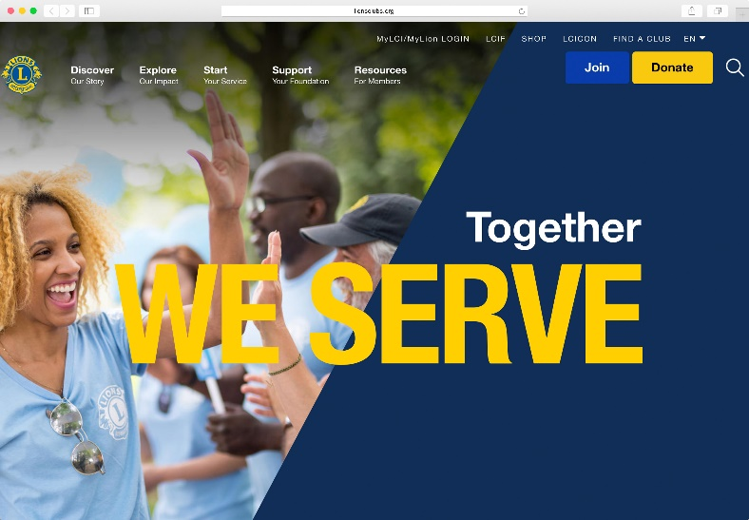
Communications
LION Magazine
E-mail Messages
Website
  lionsclubs.org
  Lion Portal
Social Networking
  Facebook
    facebook.com/lionsclubs
  Twitter
    twitter.com/lionsclubs
  YouTube
    youtube.com/lionsclubs

Slide 39
Welcome to your Lions Club!
Any Questions?
For more LCI Orientation Resources, visit:
https://www.lionsclubs.org/en/resources-for-members/resource-center/member-orientation

